Slide 1
Generative Adversarial Networks (GANs)
Amos Azaria

Slide 2
Generative Adversarial Networks
We would like to generate images (or other things) that look genuine / real.
Could be useful for:
games
simulations (e.g. for training autonomous vehicles)
Drug discovery

Slide 3
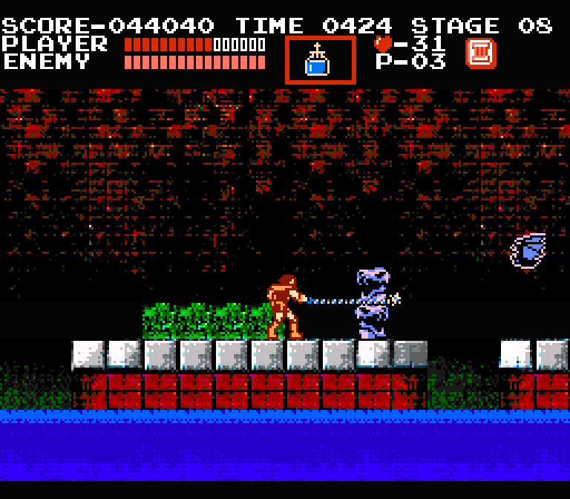
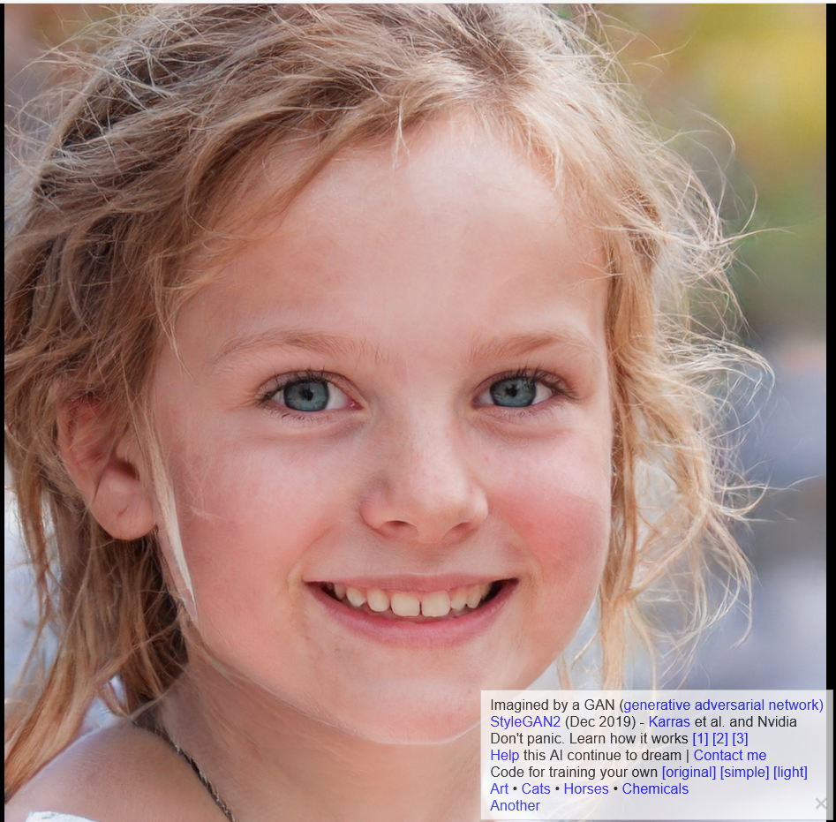
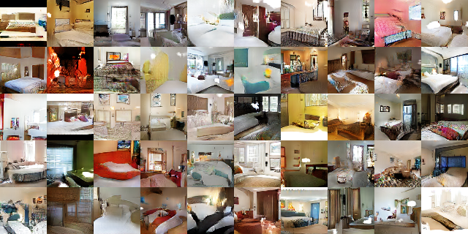
https://thispersondoesnotexist.com/
All the art in this game level is machine-generated

Slide 4
A Generative Neural Network
We would like to build a network that will generate images.
The network will start with generating random noise and them improve.
Most of the slides and code in this presentation are based on: https://www.oreilly.com/learning/generative-adversarial-networks-for-beginners

Slide 5
How will the generator improve?
Look real = indistinguishable from a real image.
Indistinguishable for whom?
Final goal is Indistinguishable for a human:
Too much work, to have humans constantly label images.
humans could be too good at the task (especially for a beginner generator network).
Indistinguishable for a neural classifier!
The classifier's (discriminator) goal is to determine which images are original and which were generated by the generator.
The generator's goal (and thus loss function) will be to generate images that the classifier will think are genuine.
Both the classifier and generator improve over time, having contrasting loss functions.

Slide 6
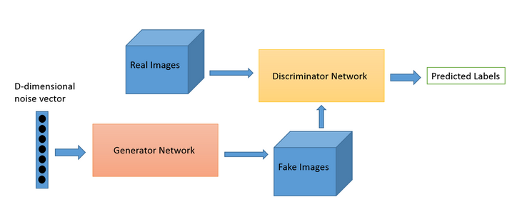
Architecture

Slide 7
Classifier's Architecture (discriminator)
Input: batch_size images of 28x28
32 filters of 5x5 (with 1x1 stride)
Average pooling of 2x2 (with 2x2 stride)
64 filters of 5x5 (with 1x1 stride)
Average pooling of 2x2 (with 2x2 stride)
1024 fully connected
Single output (per example)

Slide 8
Classifier's Code (discriminator)
def discriminator(images, reuse_variables=None):
with tf.variable_scope(tf.get_variable_scope(), reuse=reuse_variables) as scope:
d_w1 = tf.get_variable('d_w1', [5, 5, 1, 32], initializer=tf.truncated_normal_initializer(stddev=0.02))
d_b1 = tf.get_variable('d_b1', [32], initializer=tf.constant_initializer(0))
d1 = tf.nn.relu(tf.nn.conv2d(input=images, filter=d_w1, strides=[1, 1, 1, 1], padding='SAME') + d_b1)
d1 = tf.nn.avg_pool(d1, ksize=[1, 2, 2, 1], strides=[1, 2, 2, 1], padding='SAME')
d_w2 = tf.get_variable('d_w2', [5, 5, 32, 64], initializer=tf.truncated_normal_initializer(stddev=0.02))
d_b2 = tf.get_variable('d_b2', [64], initializer=tf.constant_initializer(0))
d2 = tf.nn.relu(tf.nn.conv2d(input=d1, filter=d_w2, strides=[1, 1, 1, 1], padding='SAME') + d2)
d2 = tf.nn.avg_pool(d2, ksize=[1, 2, 2, 1], strides=[1, 2, 2, 1], padding='SAME')
d_w3 = tf.get_variable('d_w3', [7 * 7 * 64, 1024], initializer=tf.truncated_normal_initializer(stddev=0.02))
d_b3 = tf.get_variable('d_b3', [1024], initializer=tf.constant_initializer(0))
d3 = tf.reshape(d2, [-1, 7 * 7 * 64])
d3 = tf.nn.relu(tf.matmul(d3, d_w3) + d_b3)
d_w4 = tf.get_variable('d_w4', [1024, 1], initializer=tf.truncated_normal_initializer(stddev=0.02))
d_b4 = tf.get_variable('d_b4', [1], initializer=tf.constant_initializer(0))
d4 = tf.matmul(d3, d_w4) + d_b4
return d4

Slide 9
Generator's Architecture
No input.
Generate random vector of batch_size x 100
3136 fully connected
reshape to 56x56 + Batch normalization + Relu
50 filters of 3x3 (with 2x2 stride)
Batch normalization + Relu + resize to 56x56
25 filters of 3x3 (with 2x2 stride)
Batch normalization + Relu + resize to 56x56
1 filter of 1x1 (with 2x2 stride)
Sigmoid activation
Output: batch_size x 28 x 28
Why? How?
Trial and error… (they worked on it for weeks, but I believe that this could still be significantly improved)

Slide 10
Generator's Code
def generator(batch_size):
z = tf.random_normal([batch_size, 100], mean=0, stddev=1, name='z')
g_w1 = tf.get_variable('g_w1', [100, 3136], dtype=tf.float32, initializer=tf.truncated_normal_initializer(stddev=0.02))
g_b1 = tf.get_variable('g_b1', [3136], initializer=tf.truncated_normal_initializer(stddev=0.02))
g1 = tf.matmul(z, g_w1) + g_b1
g1 = tf.reshape(g1, [-1, 56, 56, 1])
g1 = tf.contrib.layers.batch_norm(g1, epsilon=1e-5, scope='bn1')
g1 = tf.nn.relu(g1)
g_w2 = tf.get_variable('g_w2', [3, 3, 1, 50], dtype=tf.float32, initializer=tf.truncated_normal_initializer(stddev=0.02))
g_b2 = tf.get_variable('g_b2', [50], initializer=tf.truncated_normal_initializer(stddev=0.02))
g2 = tf.nn.conv2d(g1, g_w2, strides=[1, 2, 2, 1], padding='SAME') + g_b2
g2 = tf.contrib.layers.batch_norm(g2, epsilon=1e-5, scope='bn2')
g2 = tf.nn.relu(g2)
g2 = tf.image.resize_images(g2, [56, 56])
g_w3 = tf.get_variable('g_w3', [3, 3, 50, 25], dtype=tf.float32, initializer=tf.truncated_normal_initializer(stddev=0.02))
g_b3 = tf.get_variable('g_b3', [25], initializer=tf.truncated_normal_initializer(stddev=0.02))
g3 = tf.nn.conv2d(g2, g_w3, strides=[1, 2, 2, 1], padding='SAME') + g_b3
g3 = tf.contrib.layers.batch_norm(g3, epsilon=1e-5, scope='bn3')
g3 = tf.nn.relu(g3)
g3 = tf.image.resize_images(g3, [56, 56])
g_w4 = tf.get_variable('g_w4', [1, 1, 25, 1], dtype=tf.float32, initializer=tf.truncated_normal_initializer(stddev=0.02))
g_b4 = tf.get_variable('g_b4', [1], initializer=tf.truncated_normal_initializer(stddev=0.02))
g4 = tf.nn.conv2d(g3, g_w4, strides=[1, 2, 2, 1], padding='SAME') + g_b4
g4 = tf.sigmoid(g4)
return g4

Slide 11
Defining losses and optimizers
batch_size = 50
# for feeding images to the discriminator
x_placeholder = tf.placeholder(tf.float32, shape = [None,28,28,1], name='x_placeholder')
Gz = generator(batch_size) # Gz holds the generated images
Dx = discriminator(x_placeholder) # Discriminator prediction probabilities for the real images
Dg = discriminator(Gz, reuse_variables=True) # Discriminator prediction probabilities for generated images
d_loss_real = tf.reduce_mean(tf.nn.sigmoid_cross_entropy_with_logits(logits = Dx, labels = tf.ones_like(Dx)))
d_loss_fake = tf.reduce_mean(tf.nn.sigmoid_cross_entropy_with_logits(logits = Dg, labels = tf.zeros_like(Dg)))
g_loss = tf.reduce_mean(tf.nn.sigmoid_cross_entropy_with_logits(logits = Dg, labels = tf.ones_like(Dg)))
tvars = tf.trainable_variables()
d_vars = [var for var in tvars if 'd_' in var.name]
g_vars = [var for var in tvars if 'g_' in var.name]
d_trainer_fake = tf.train.AdamOptimizer(0.0003).minimize(d_loss_fake, var_list=d_vars)
d_trainer_real = tf.train.AdamOptimizer(0.0003).minimize(d_loss_real, var_list=d_vars)
g_trainer = tf.train.AdamOptimizer(0.0001).minimize(g_loss, var_list=g_vars)
tf.get_variable_scope().reuse_variables()
-y_log(sigmoid(Dx)) - (1-y_)log(sigmoig(1-Dx))
because we set y_=1 it's equal to -log(sigmoid(Dx))
Returns a tensor with all values set to 1 (with shape of Dx)
g_loss is the opossite of d_loss_fake!
Each trainer trains only its own variables

Slide 12
Train!
sess.run(tf.global_variables_initializer())
# Pre-train discriminator
for i in range(300):
real_image_batch = mnist.train.next_batch(batch_size)[0].reshape([batch_size, 28, 28, 1])
_, __ = sess.run([d_trainer_real, d_trainer_fake], {x_placeholder: real_image_batch})
# Train generator and discriminator together
for i in range(100000):
real_image_batch = mnist.train.next_batch(batch_size)[0].reshape([batch_size, 28, 28, 1])
# Train discriminator on both real and fake images
_, __ = sess.run([d_trainer_real, d_trainer_fake], {x_placeholder: real_image_batch})
# Train generator
_ = sess.run(g_trainer)

Slide 13
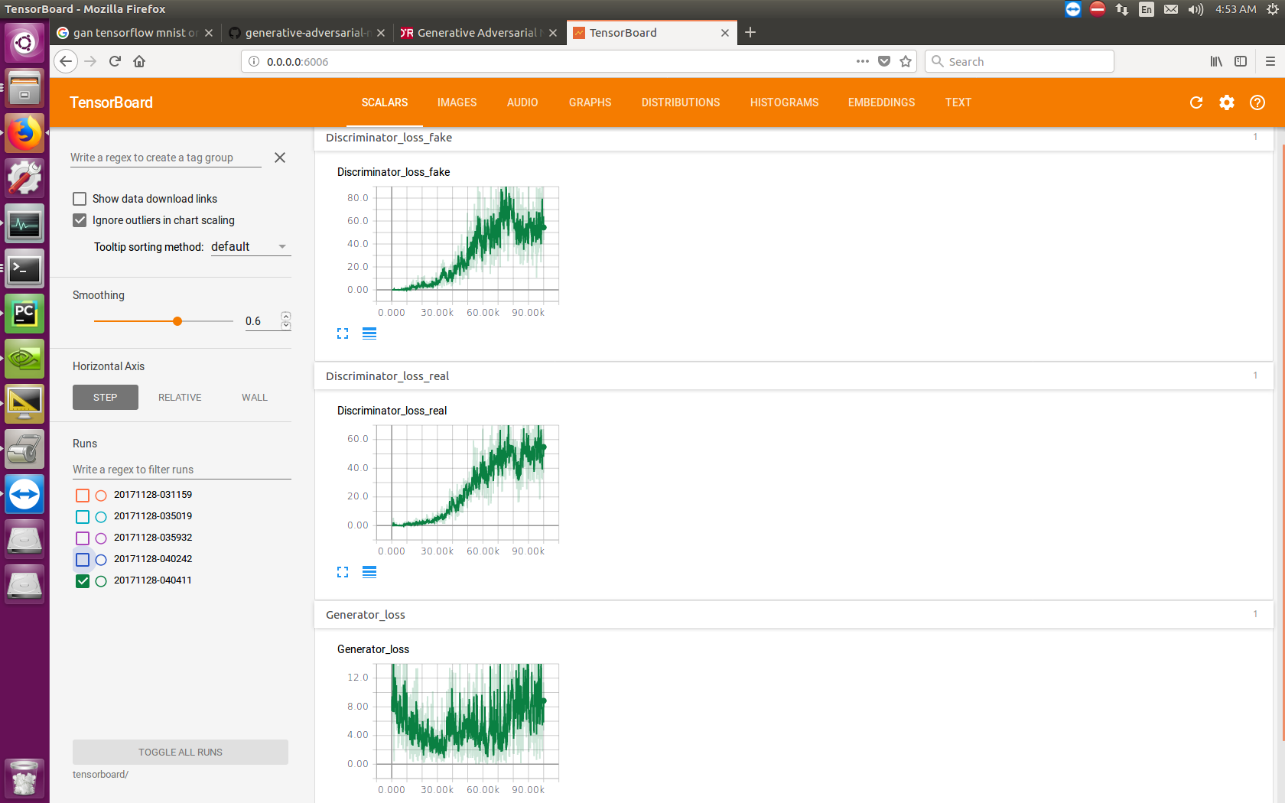
Tensorboard

Slide 14
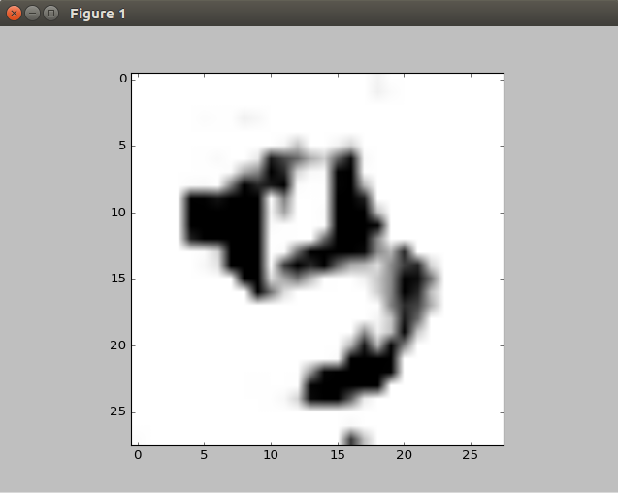
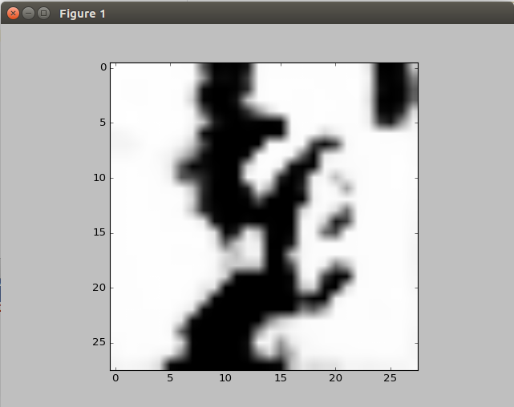
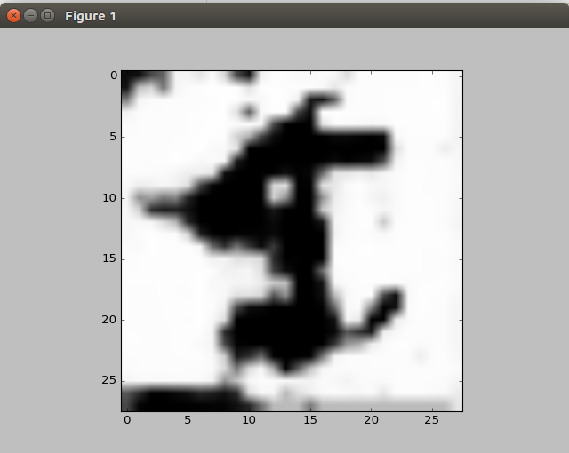
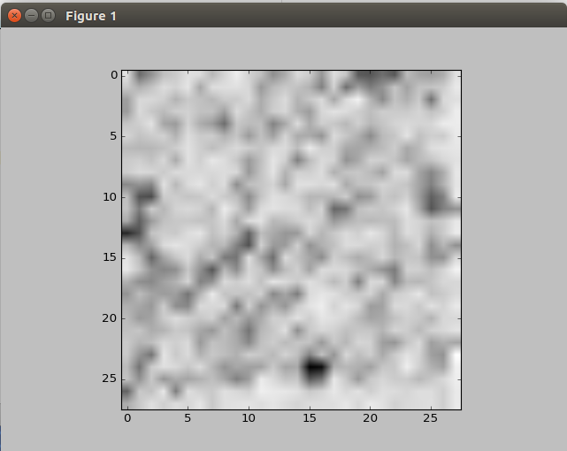
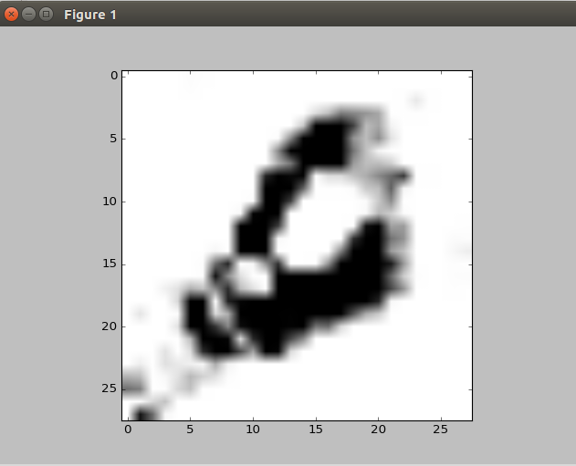
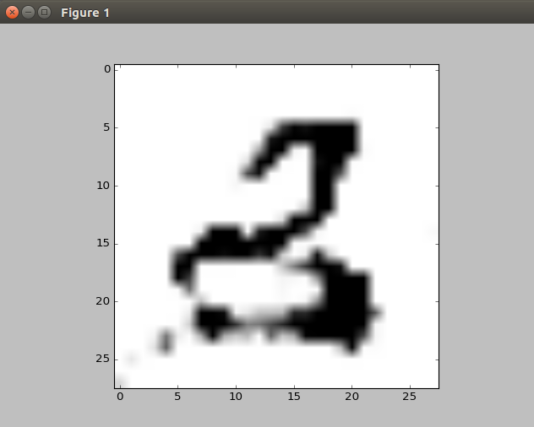
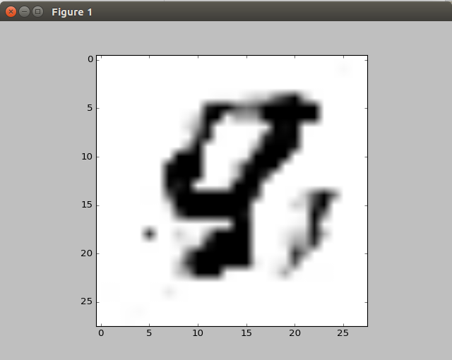
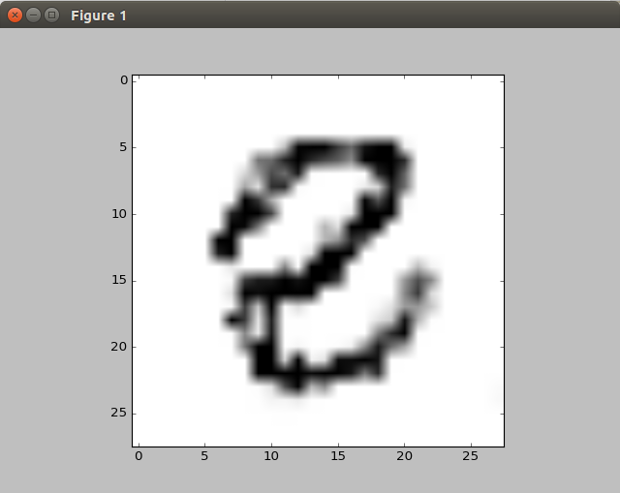
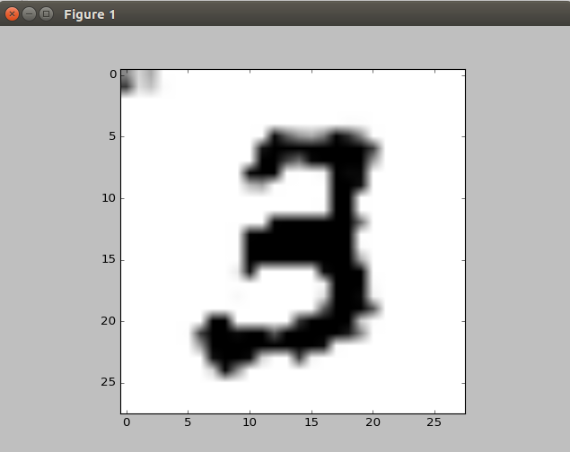
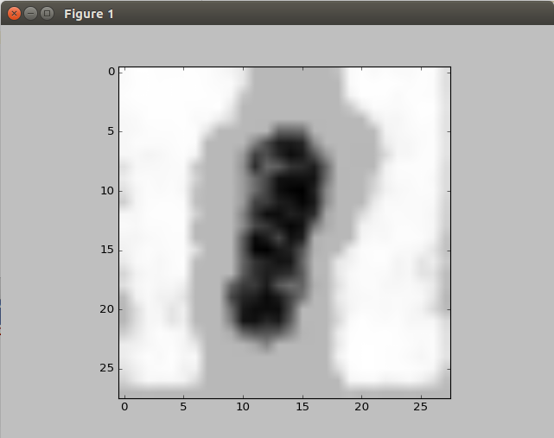
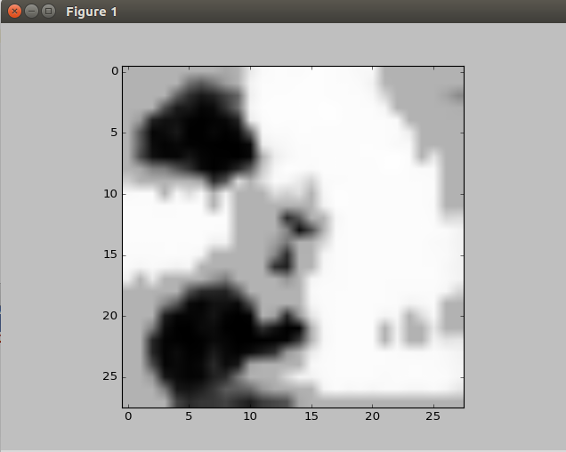
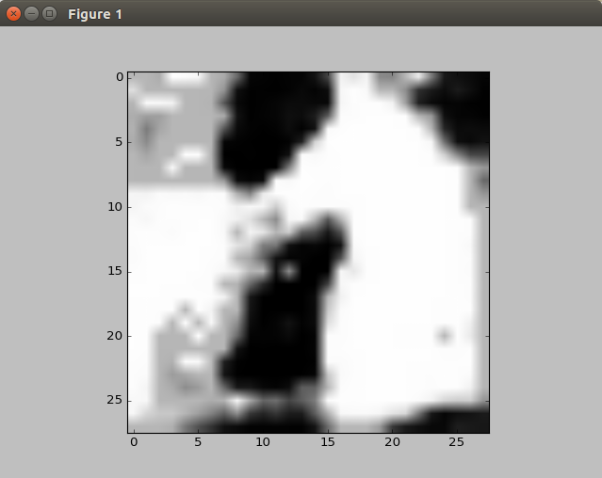
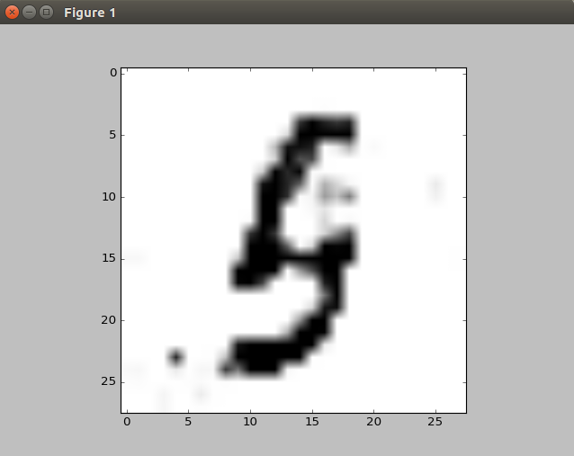
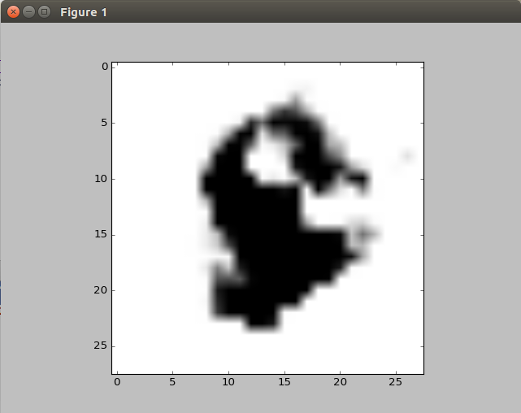
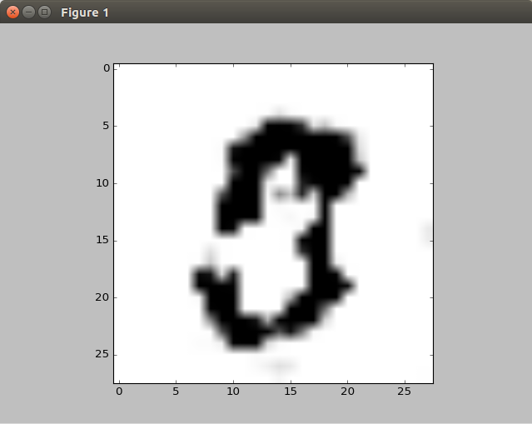
Results!
If the generator manages to fool the discriminator on one digit (e.g. 3) it isn't good enough, because the discriminator will learn to assign low values to that digit.

Slide 15
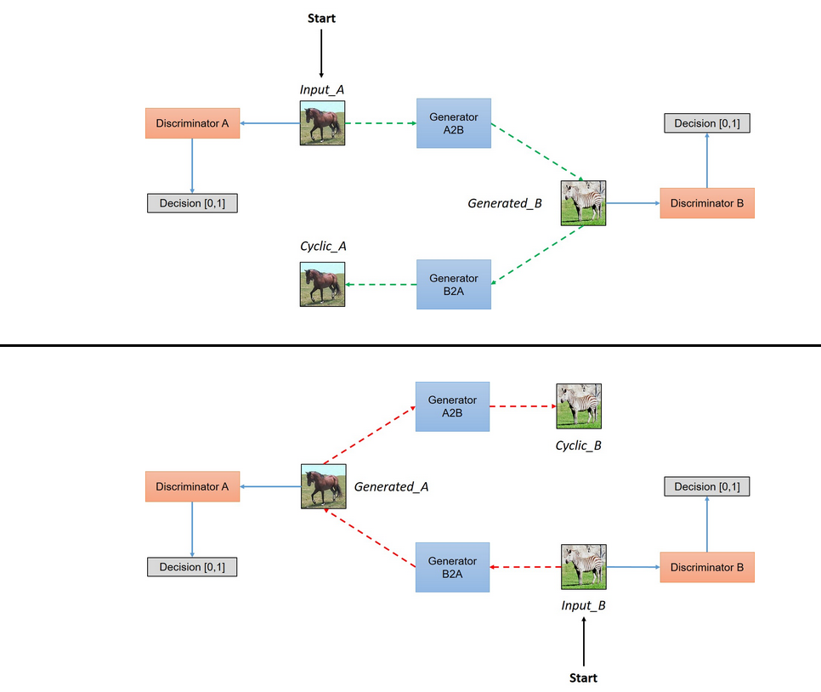
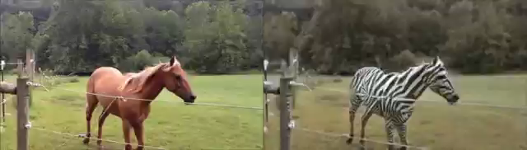
Cycle Gan
Loss terms includes L2 distance (+regular GAN loss)
Loss terms includes L2 distance (+regular GAN loss)
See https://hardikbansal.github.io/CycleGANBlog/ for Tensorflow code
Notes:
The cycle alone does not promise any relationship between the horse and the zebra, it requires the middle layers to not be completely flattened.
See more examples here: http://shikib.com/CycleGan.html

